Slide 1
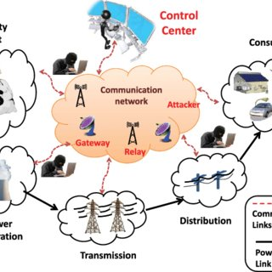
Intrusion attack detection in power system network
Team members:
Arpita Biswas
Santu Dinda
Shrutayu Naskar
Fajle Sarup Hossain
Supervisor :
Prof. Debasish Biswas
Team name: ftx100

Slide 2

Agenda
abstract
Introduction
Primary goals of CNN
Areas of Project
Timeline
Summary

Slide 3


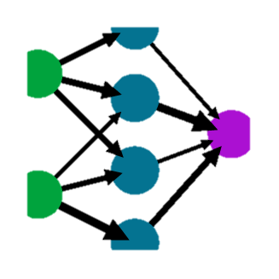

abstract
ML
Machine learning is an application of artificial intelligence that involves algorithms and data that automatically analyze and make decision by itself without human interaction.
It describe how computer perform tasks on their own by previous experiences
CNN
Convolutional Neural Network (CNN) is a specialized type of artificial neural networks that used mathematical operation called Convolution in place of general matrix multiplication in at least one of their layers.
They are specifically designed to process pixel data and are used in image recognition and processing.
Project ideas
Power system disturbances and detecting cyber-attacks with the help of machine learning methods and discuss the practical implications for deploying machine learning systems as an enhancement to existing power system architectures.

Slide 4

Introduction
Overall Power system disturbances are inherently complex and can be attributed to a wide range of sources, including both natural and man-made events.
Currently, the power system operators are heavily relied on to make decisions regarding the causes of experienced disturbances and the appropriate course of action as a response.
In the case of cyber-attacks against a power system, human judgment is less certain since there is an overt attempt to disguise the attack and deceive the operators as to the true state of the system.
To enable the human decision maker, we explore the viability of machine learning as a means for discriminating types of power system disturbances, and focus specifically on detecting cyber-attacks where deception is a core tenet of the event.
We evaluate machine learning methods as disturbance discriminators and discuss the practical implications for deploying machine learning systems as an enhancement to existing power system architectures.

Slide 5

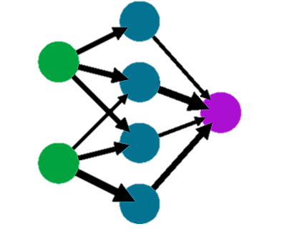
Primary goals
Convolution neural network

Slide 6
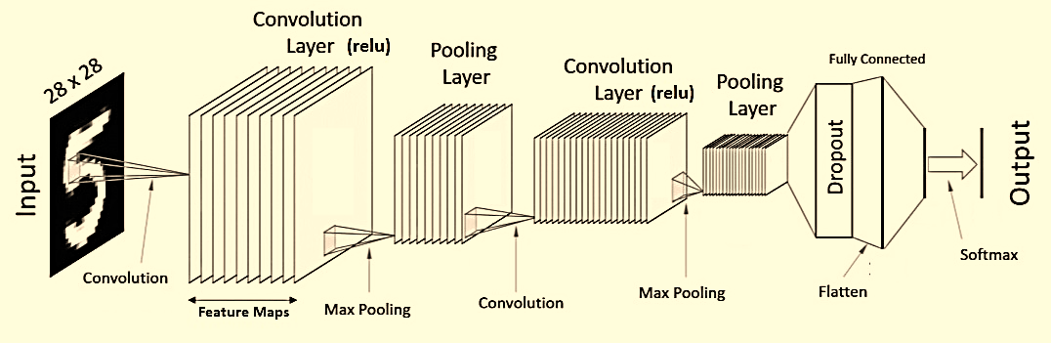
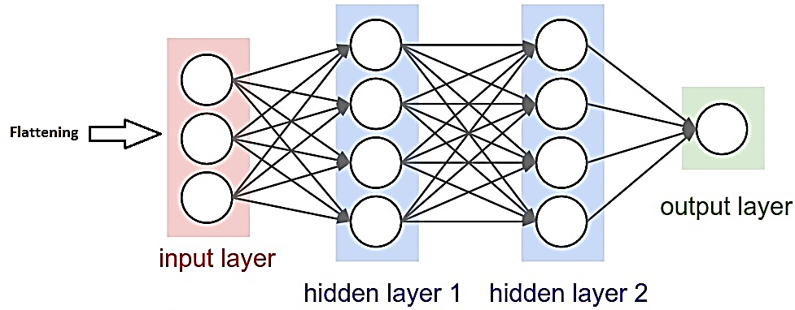
Convolutional neural networks (CNN)
CNN is used for image Classification, object detection
Convolution Operation:
We have some image or matrix (10*10) and feature detector ( 3*3)
Feature detector = Kernel = Filter
Feature detector detects features like edges or convex shapes.
Feature map = conv(input image, feature detector). Element wise multiplication of matrix.
Feature map = Convolved feature
Stride = navigate in input image
We reduce the size of image. This is important bc code runs faster.
We create multiple feature maps bc we use multiple feature detectors ( Filter).

Slide 7
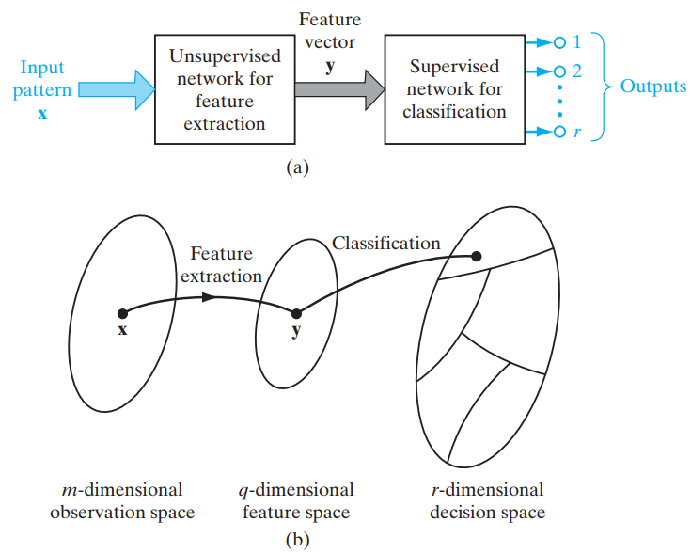
Pattern recognition
The task of feature extraction is performed by the computational units in the hidden layer(s) of the network.
The machine is designed as a feedforward network using a supervised learning algorithm.

Slide 8

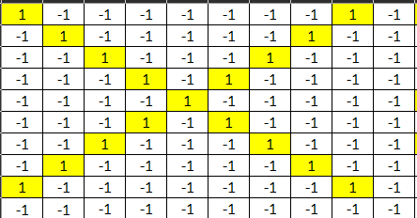


Convolutional neural networks (CNN)
Filter - 1
convolution
Filter - 2
Filter - 3
Input Matrix (10*10)
Feature Maps (3*3)

Slide 9
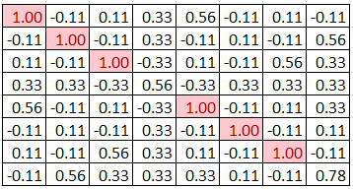
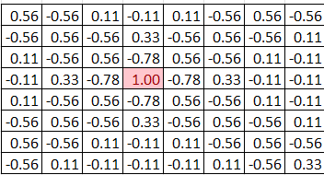
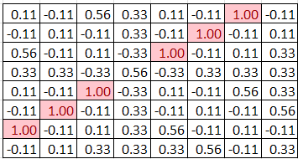
Convolutional neural networks (CNN)
Input Matrix (10*10)
Feature Maps (3*3)
Convolution Layers(8*8)

Slide 10
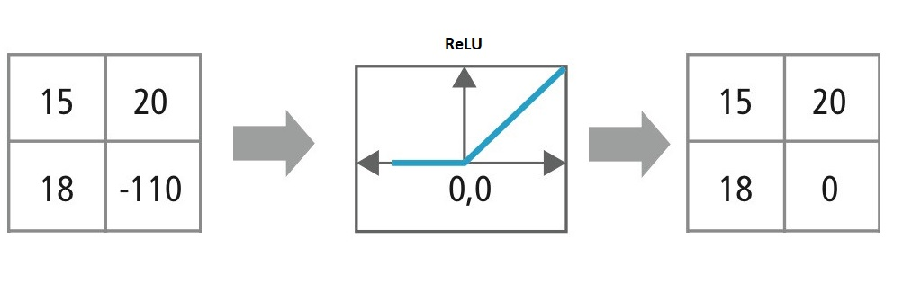
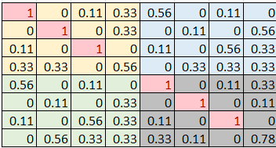


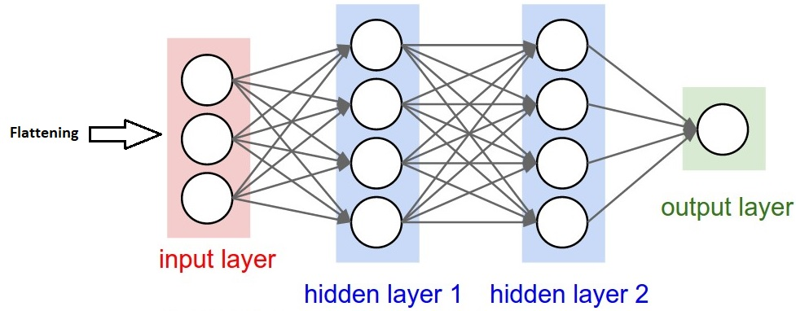
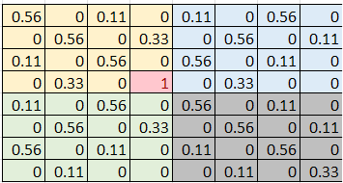

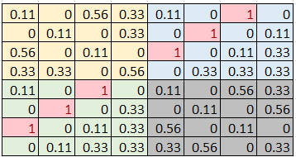

Convolutional neural networks (CNN)
After having convolution layer we use ReLU to break up linearity. Increase non-linearity . Because image are non-linear
Max Pooling: It makes down-sampling or sub-sampling (Reduce the no. of parameters)
After Flatting all Features or Classifications are applied into the next Neural Network as
an Input
Applied Relu
Max Pooling
Flatting
Convolution Layers(8*8)
Convolution Layers(8*8)
Pooling Layers (2*2)
Features
Neural Network

Slide 11
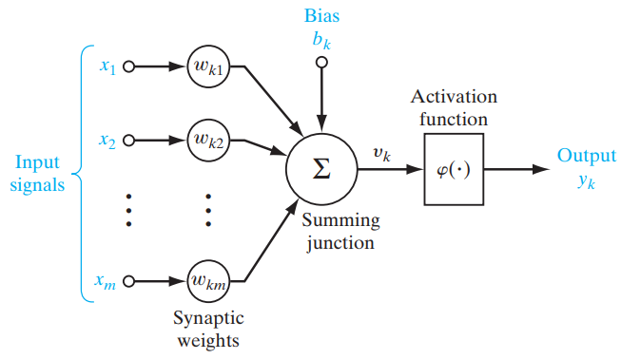
Model of neurons
Gradient Descent Algorithm
This is the simplest training algorithm used in the case of a supervised training model. In case the actual output is different from the target output, the difference or error is find out. The gradient descent algorithm changes the weights of the network in such a manner to minimize this mistake.
Back Propagation Algorithm
It is an extension of the gradient-based delta learning rule. Here, after finding an error (the difference between desired and target), the error is propagated backward from the output layer to the input layer via the hidden layer. It is used in the case of Multi-layer Neural Network.

Slide 12
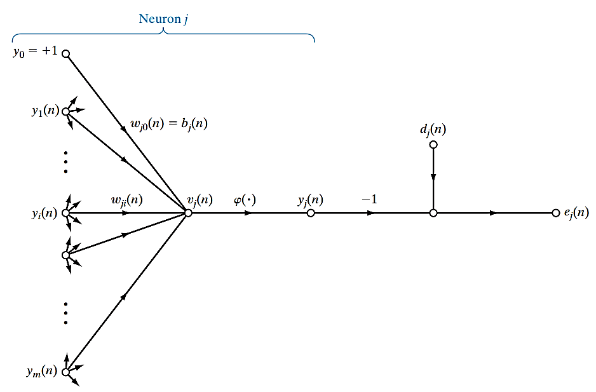
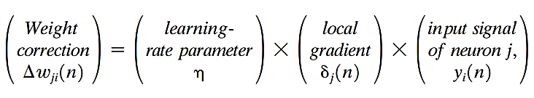
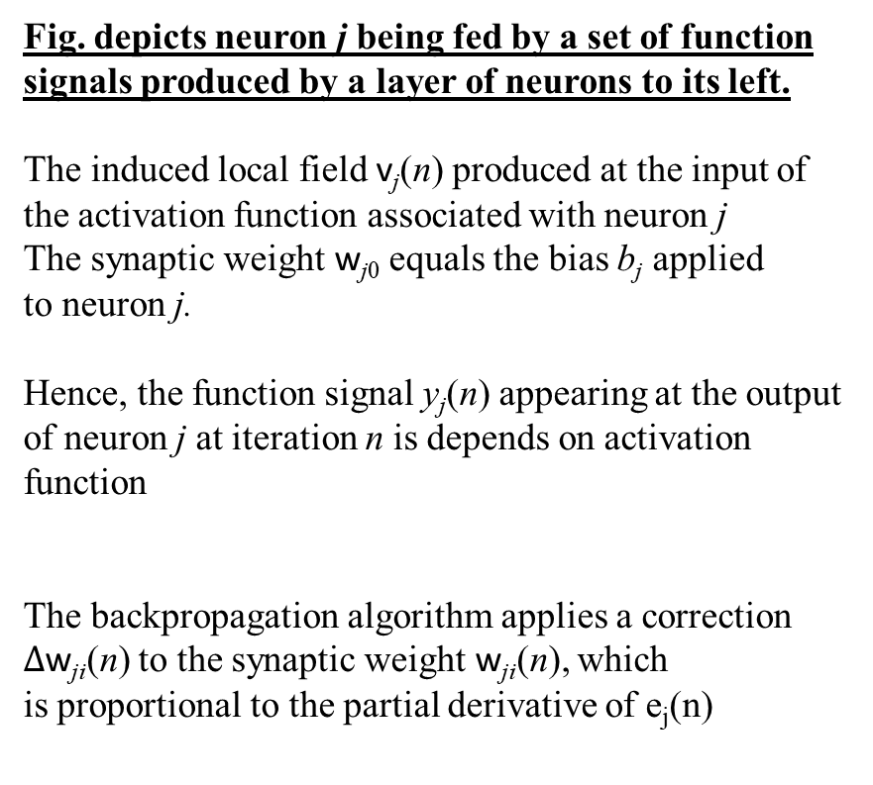
Learning algorithm
Fig. depicts neuron j being fed by a set of function signals produced by a layer of neurons to its left.
The induced local field v_{j}(n) produced at the input of the activation function associated with neuron j
The synaptic weight w_{j0} equals the bias b_{j} applied to neuron j.
Hence, the function signal y_{j}(n) appearing at the output of neuron j at iteration n is depends on activation function
The backpropagation algorithm applies a correction $∆$w_{ji}(n) to the synaptic weight w_{ji}(n), which is proportional to the partial derivative of e_{j}(n)

Slide 13
“intrusion attack detection with the help of cnn methodology in power system network .”
Areas of Project described

Slide 14
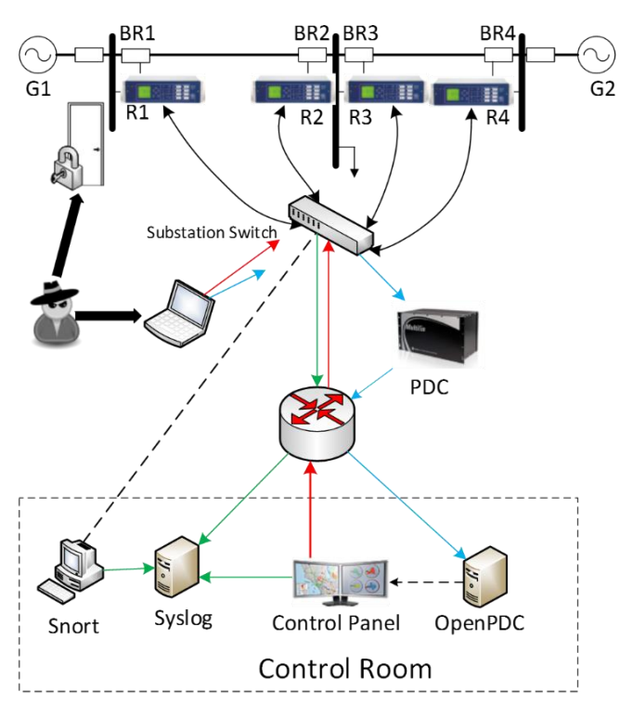
Case study: power system attack detect
The figure shows the power system framework configuration used in generating these scenarios.
In the network diagram we have several components, firstly, G1 and G2 are power generators.
R1 through R4 are Intelligent Electronic Devices (IEDs) that can switch the breakers on or off.
These breakers are labeled BR1 through BR4.
There are two lines L1 and L2.
Line One spans from breaker one (BR1) to breaker two (BR2)
Line Two spans from breaker three (BR3) to breaker four (BR4).

Slide 15
Case study: power system attack detect
Each IED automatically controls one breaker.
R1 controls BR1, R2 controls BR2 and son on accordingly.
The IEDs use a distance protection scheme which trips the breaker on detected faults whether actually valid or faked since they have no internal validation to detect the difference.
Operators can also manually issue commands to the IEDs R1 through R4 to manually trip the breakers BR1 through BR4.
The manual override is used when performing maintenance on the lines or other system components.

Slide 16
scenarios
Short-circuit fault – This is a short in a power line and can occur in various locations along the line, the location is indicated by the percentage range.
Line maintenance – One or more relays are disabled on a specific line to do maintenance for that line.
Remote tripping command injection (Attack) – This is an attack that sends a command to a relay which causes a breaker to open. It can only be done once an attacker has penetrated outside defenses.
Relay setting change (Attack) – Relays are configured with a distance protection scheme and the attacker changes the setting to disable the relay function such that relay will not trip for a valid fault or a valid command.
Data Injection (Attack) – Here we imitate a valid fault by changing values to parameters such as current, voltage, sequence components etc. This attack aims to blind the operator and causes a black out.

Slide 17
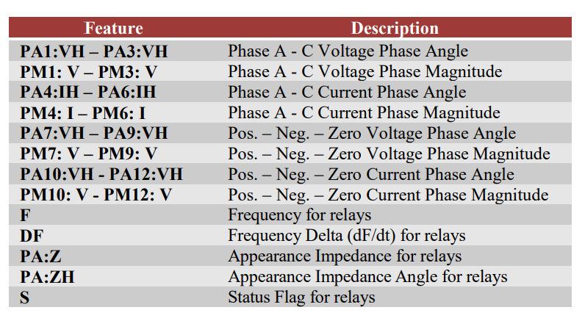
Description of Features

Slide 18
Classification problems
The 128 features are explained.
There are 29 types of measurements from each phasor measurement units (PMU).
A phasor measurement unit (PMU) or synchro-phasor is a device which measures the electrical waves on an electricity grid, using a common time source for synchronization.
In our system there are 4 PMUs which measure 29 features for 116 PMU measurement columns total.

Slide 19
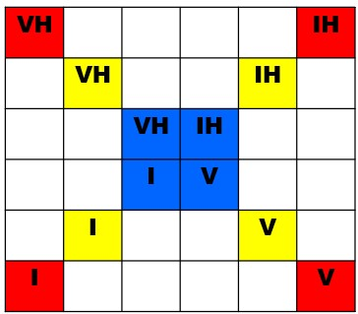



IMPLEMENTATION OF CNN IN IDS OF POWER SYSTEM
Formation of input Image:
Extract required parameters of relays for each and every phase from entire datasheet
Make an Image and shape looks like “X”
Here, For Relay-1, entire 3-phase
VH - Voltage phase angle
IH – Current phase angle
I – Current magnitude
V – Voltage Magnitude
Applied Input Image for CNN
Features extraction:
These are the features of Input Image “X”
Three different types of Features

Slide 20

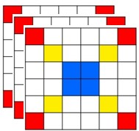

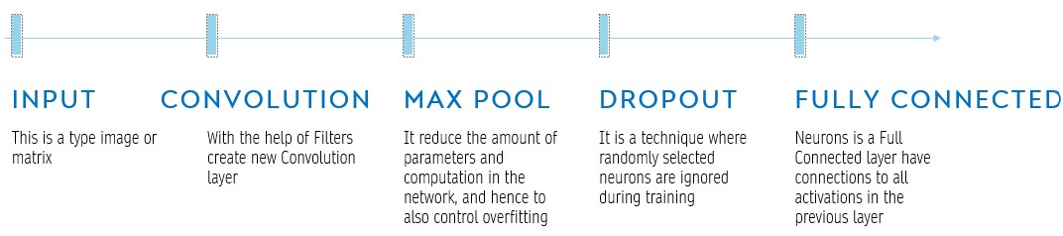
IMPLEMENTATION OF CNN IN IDS OF POWER SYSTEM
Convolution Layer (ReLU)
6 x 6
Pooling Layer
Flatten
Convolution Layer
Flatten
Pooling Layer
Vector
Output Image
Input
Features
Features Maps
Convolution
Convolution
Max Polling
Max Polling

Slide 21
IMPLEMENTATION OF CNN IN IDS OF POWER SYSTEM
Import datasheet:
dsheet = pd.read_csv("D:\Project\#1.FTX100_TINT\FTX_Model_Demo 11.05.23\data9_1.csv")
dsheet.head()
-> Size of Datasheet: (15582 rows x 129 columns)
Extract required Data form datasheet:
relay1 = dsheet.loc[:,['R1-PA1:VH’, 'R1-PA2:VH’, 'R1-PA3:VH’, 'R1-PM1:V’, 'R1-PM2:V’, 'R1-PM3:V’,
'R1-PA4:IH’, ’R1-PA5:IH’, 'R1-PA6:IH’, 'R1-PM4:I’, 'R1-PM5:I’, 'R1-PM6:I’, 'R1:S']]
relay1.head()
-> Size of Datasheet: (15582 rows x 13 columns)
Drop status flag & label encoding (Y):
relay11 = relay1.drop('R1:S', axis=1 )
relay11 -> Size of Datasheet: (15582 rows x 12 columns)
Consider an Input Image & transfer to an array:
Fault_Data_TrainX.shape : 15582, (3, 2, 2)
Fault_Data_TrainY.shape : 15582, 6

Slide 22
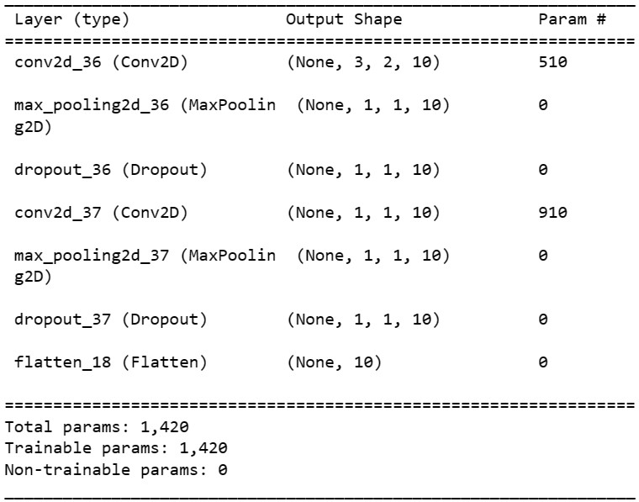
IMPLEMENTATION OF CNN IN IDS OF POWER SYSTEM
Divide datasheet as a Train & Test purpose [ 8 : 2 ]:
x_train shape : 14023, (3, 2, 2)
x_test shape : 1559, (3, 2, 2)
y_train shape : 14023, (6)
y_test shape : 1559, (6)
Apply ReLU function & Maxpulling operation:
Len( X_train) : 14023
X_train.shape: 14023, (3, 2, 2)
Len(Y_val) : 1559
Y_val.shape : 1559, 6
Dropout the features and flatten operation:

Slide 23
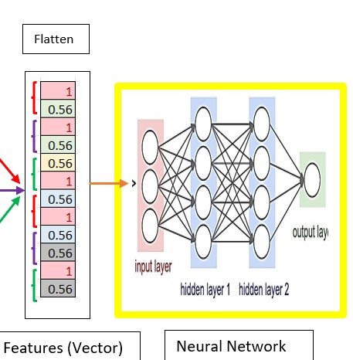

IMPLEMENTATION OF CNN IN IDS OF POWER SYSTEM
Shape the flatten parameters as a vector format:
Apply vector parameters as an input for Neural Network:
Match output image with desired input image:
Apply backpropagation if both output Image is not same:
Analyze output Image and losses :
Finding Validation Loss
Make Convolution matrix

Slide 24
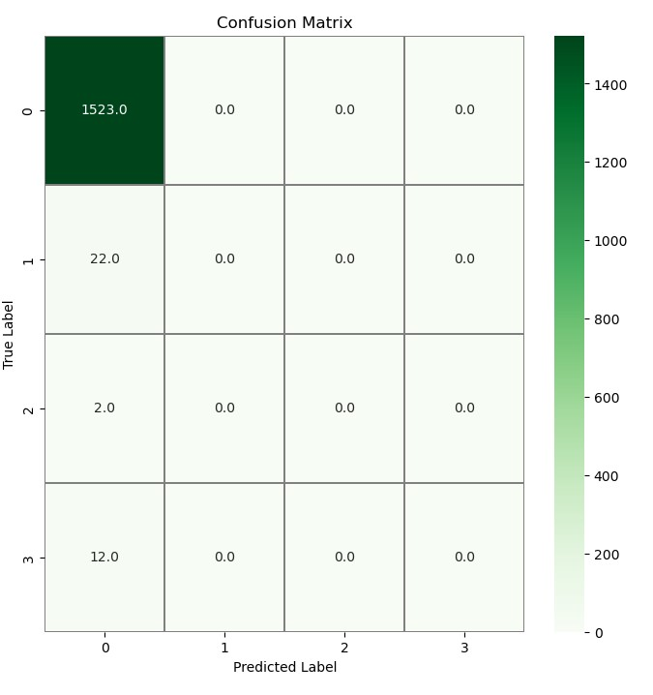
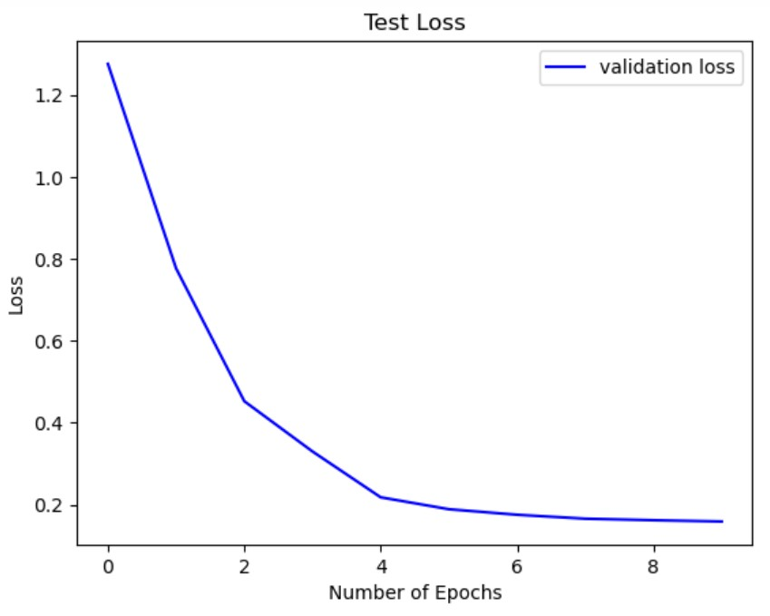
IMPLEMENTATION OF CNN IN IDS OF POWER SYSTEM
Results: Identify losses and analyze output image
Fig: Validation Loss
Fig: Convolution matrix

Slide 25

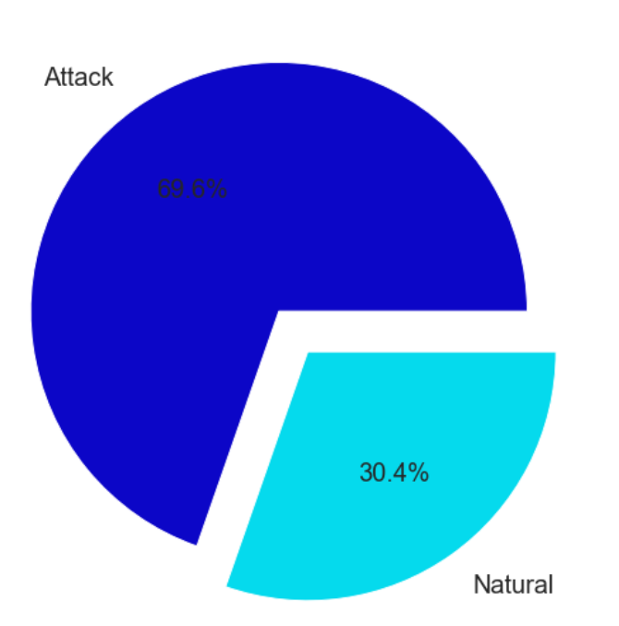
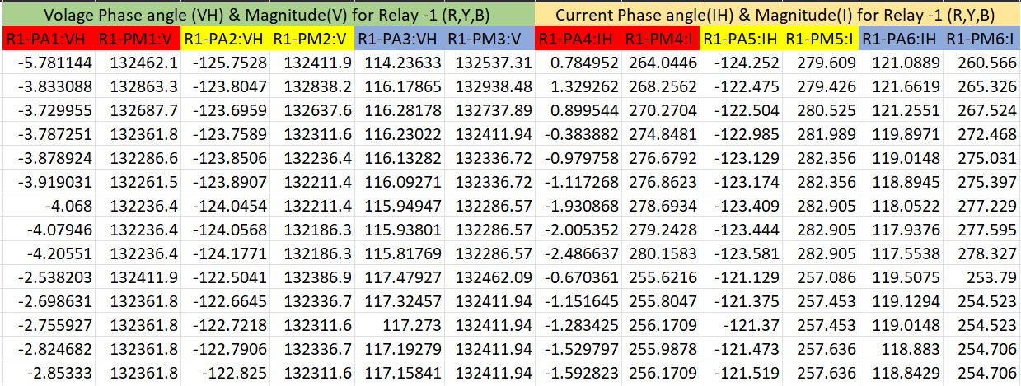
Data description
Sample Data for IED (Relay- 1)

Slide 26

Summary
We have established initial benchmarks for applying machine learning approaches to power system disturbance classification on a smart power grid framework.
we were able to reliably classify power system disturbances with low false positive rates.
Therefore, based on the results of applying learning methods to this power system data, we conclude that machine learning is a viable approach to providing reliable decision support to power system operators on whether the system is under attack.
However, this presentation serves as an initial set of evidence for the application of machine learning in this domain and motivation for further project.

Slide 27

Thank you
ftx100​
Techno international new town || department of electric engineering

